Slide 1
Selection,Care and handling of hatching eggs
Now a days in india hatching of eggs developed as an industry. Because of the introduction of famous, internationally known breeds like Bobcock,Abbor Acres, Shavers,De-Kalb,Keystones etc. now there are few hundred hatcheries present in India both in private and public sectors.But in India there is no quality to check the production of substandard chicks. Hatching will be completed with in 21 days in a fertile egg.During this process the developing embryo utilises the food material from egg yolk and albumen . So care should be taken while selecting the eggs for hatching

Slide 2
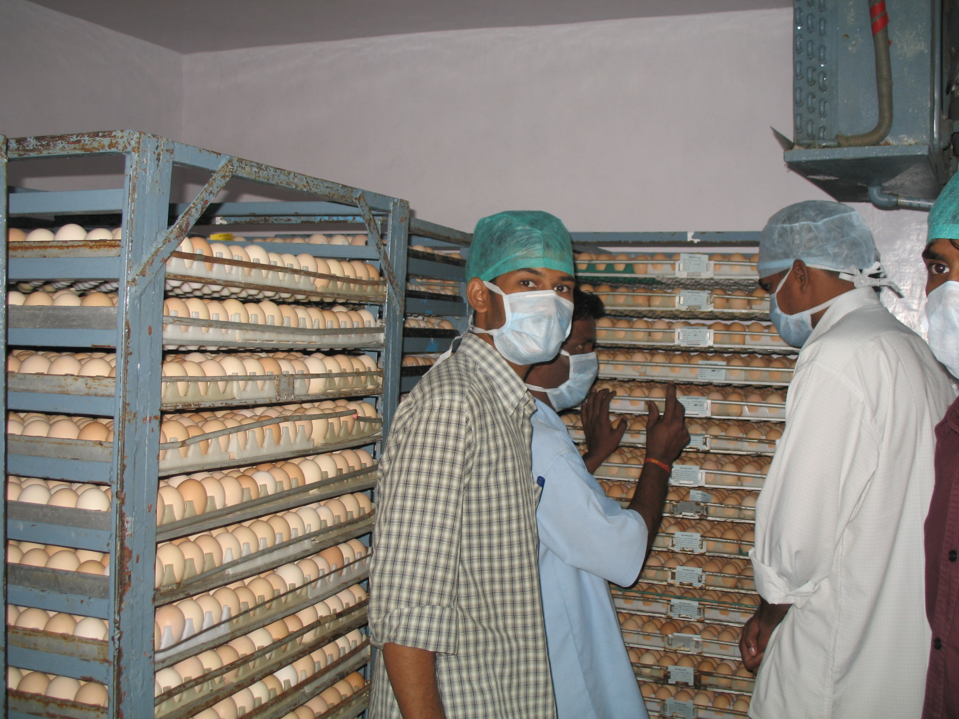

Slide 3
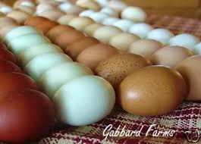

Slide 4
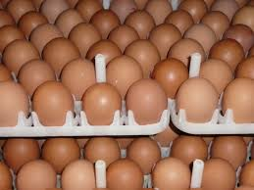

Slide 5
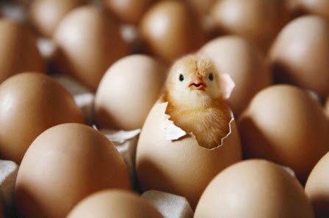

Slide 7
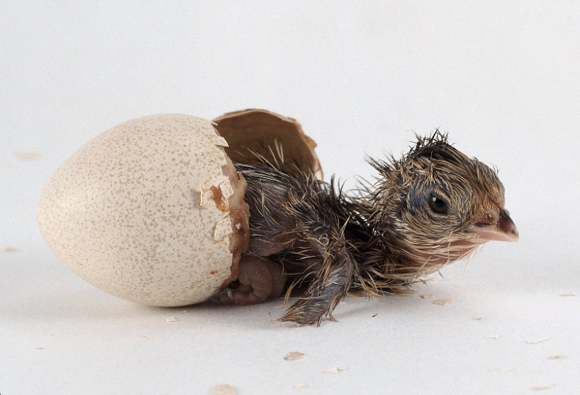

Slide 8
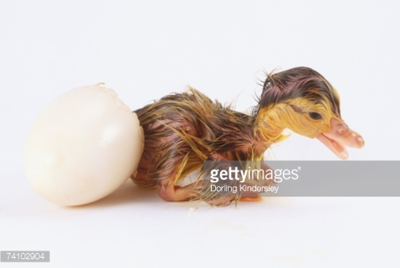

Slide 9
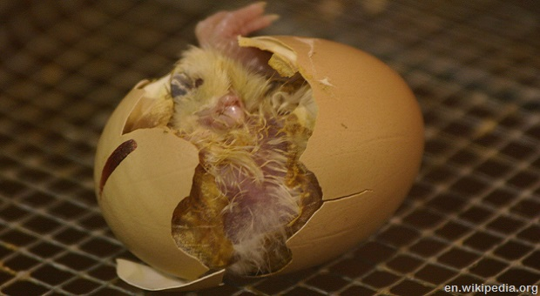

Slide 10
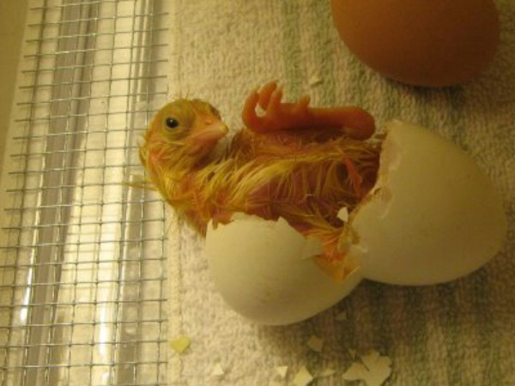

Slide 11
Selectionofhatchingeggs: The fertile egg only contains the embryo which produce chick later on hatching. The hen produces fertile eggs, after mating with male only, for this the flock needs sufficient roosters.Before selecting the eggs for hatching the following factors should be observed about the breeding flock. (1)ConditionofBreedingFlock: (a) Nutritional Food: The fowls can produce eggs with out providing a complete Nutritional food. But this type eggs do not produce a strong and healthy chick. In view of this to get a good quality eggs the hens should be fed with good protein rich complete diet. Cocks also be provided with this diet three or four months before mating

Slide 12
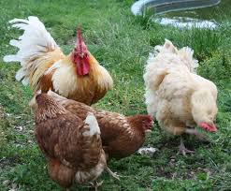

Slide 13
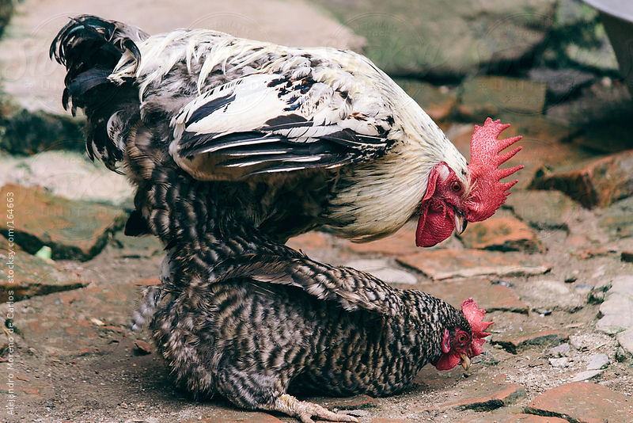

Slide 14
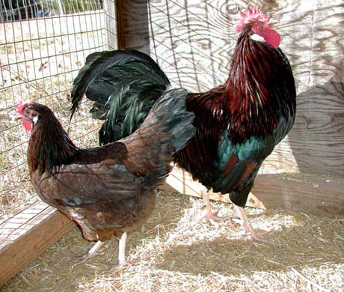

Slide 15
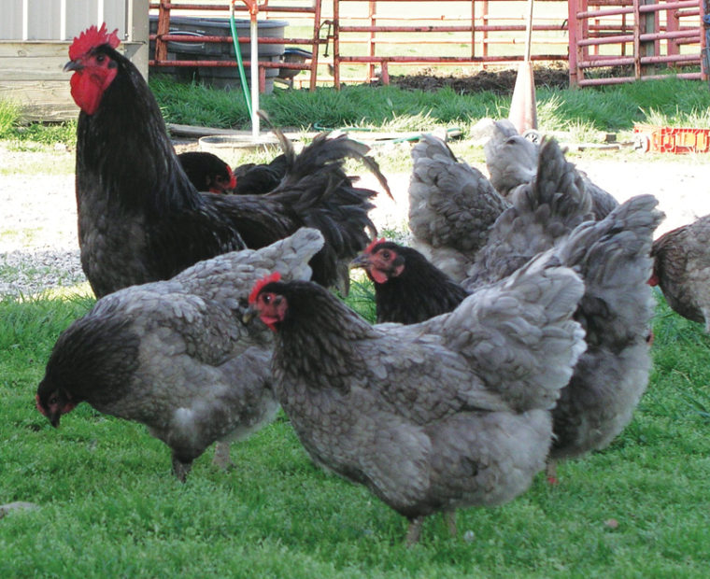

Slide 16
B.Healthy hens
Some of the diseases(typhoid, paralysis) carry through eggs from one generation to other. So, while selecting the eggs health of the birds is he prime concern to observe. The eggs produced by mating with strong healthy males and females becomes more fertile and hatchability also more

Slide 17
C.Age of the breeding flock
Old cock can mate only with small no of hen but no effect on hatchability of egg. but in hens % of hatchability observed in eggs produced in the first year of production
D. egg production: when the hen produces more eggs rate of fertility and hatchability is also more, gradually this may be decreased on both the counts.
Besides these the following points also be considered
The eggs produced - summer show the rate of fertility and hatchablity very low
While in flock mating one good, strong and healthy male should be provided for a flock of 20 hens.
The eggs should not be kept or stored not more than 3to 4 days in summer,7 days in winter

Slide 18
Condition of eggs (a) size of eggs-53 gms (b)Shell colour and quality: white ,avoid tinted eggs,brown eggs (c)Tremulous air cells age of the egg, cleanliness Care of hatching eggs (1)Care of eggs (a)Collection of eggs- extreme -frequent (b)Fumigation -20 mts. (c) Transportation-24 hrs

Slide 19
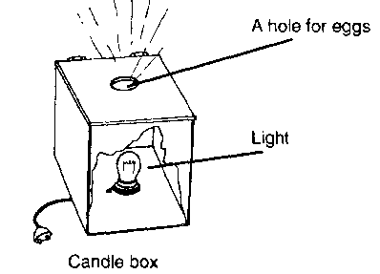
Candling of eggs
Notes:
Candling of eggs

Slide 20
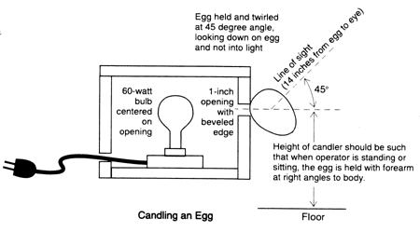

Slide 21
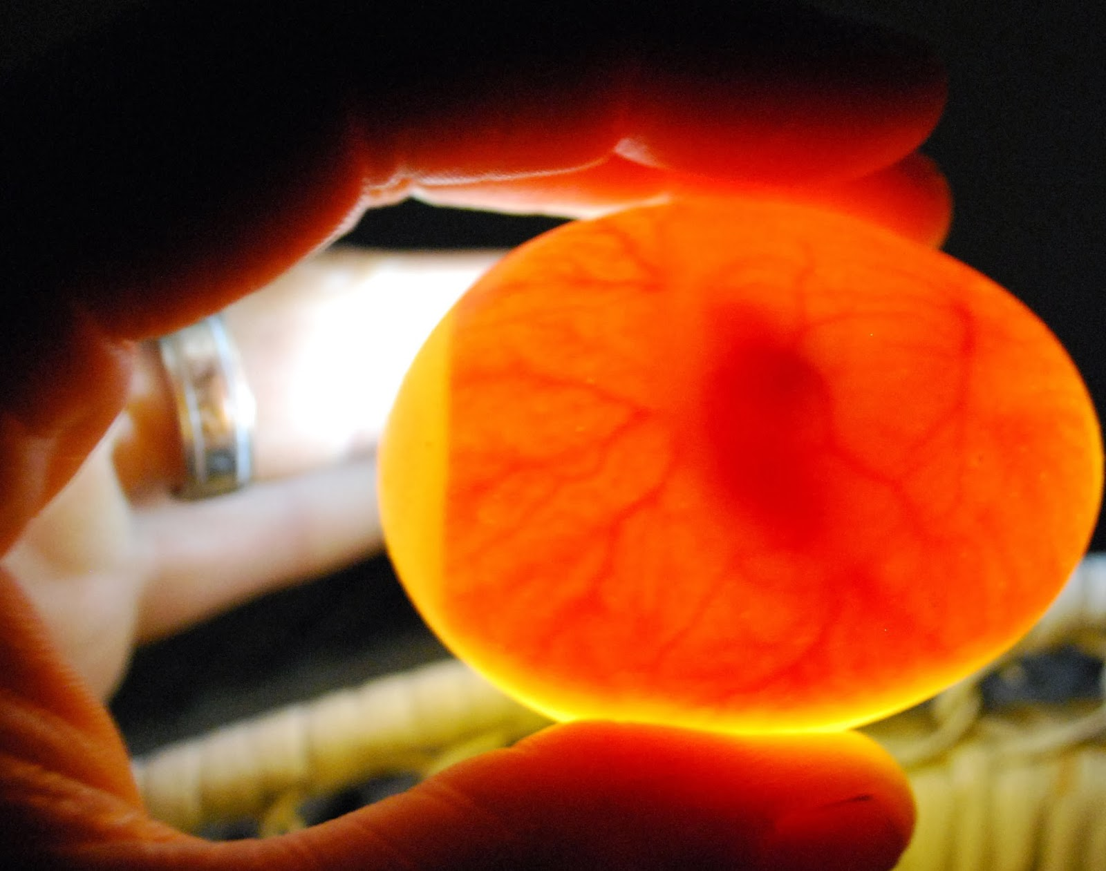

Slide 23
